Slide 1
Presentation on Interface
Presented by: <Dipesh Tha Shrestha>
Presented To: <Akash Deo>

Slide 2
Classic tech Mobile Application Interface
Interface of classic tech mobile application is simple and easy to use. Classic Tech App is an exclusive application developed for customers to provide various services in the digital platform. Customers can get all types of care services through this app without any issues and hassle. All of the services provided to customers can be used via this application.

Slide 3
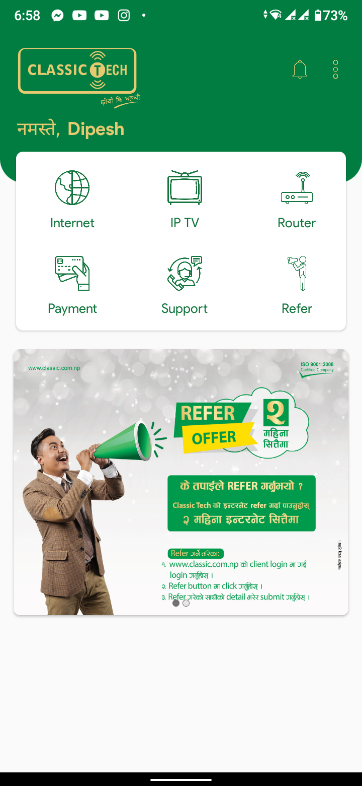
Classic tech Application Interface Demo

Slide 4
Features of Interface
Clear and intuitive user navigation
Familiar UI elements
Easy to use
Easy to understand

Slide 5
Advantage of this interface
People can check the internet usage.
People can change password of wifi easily.
People can report their problem easily.
Payment can be done through it.
Device filtering
Graphical Display of Packages

Slide 6
Disadvantage of this interface
loading problem.
Design is inconsistent
Lack of social login.
It is slow.
Interface is not responsive.

Slide 7
services provided
• View list of connected devices • Change Wi-Fi SSID and password • Option to publicly show SSID or not • Port Status • Add or remove MAC Filtering

Slide 8
What need to be added
Black listing.
Wife range management
Additional tips and tricks
attractive visuals
Speed test

Slide 9
Usability issue in this interface
Unclear content
Unresponsive gesturization
No Way To Search
Slow loading
Going backwards

Slide 10
What should be done to improve the interface?
Use Contrast To Manage Focus
Use Color To Manage Attention
Use Unique icon
Improve loading speed

Slide 11
Thank you

